Slide 1
Do(n’t) Say “Future”!
——a short film of slit-scan performance
SM3805 Imaging Science Studio Final Project
GE Jingyi Joyce

Slide 2
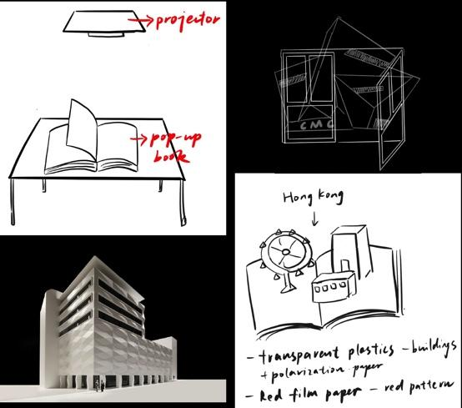
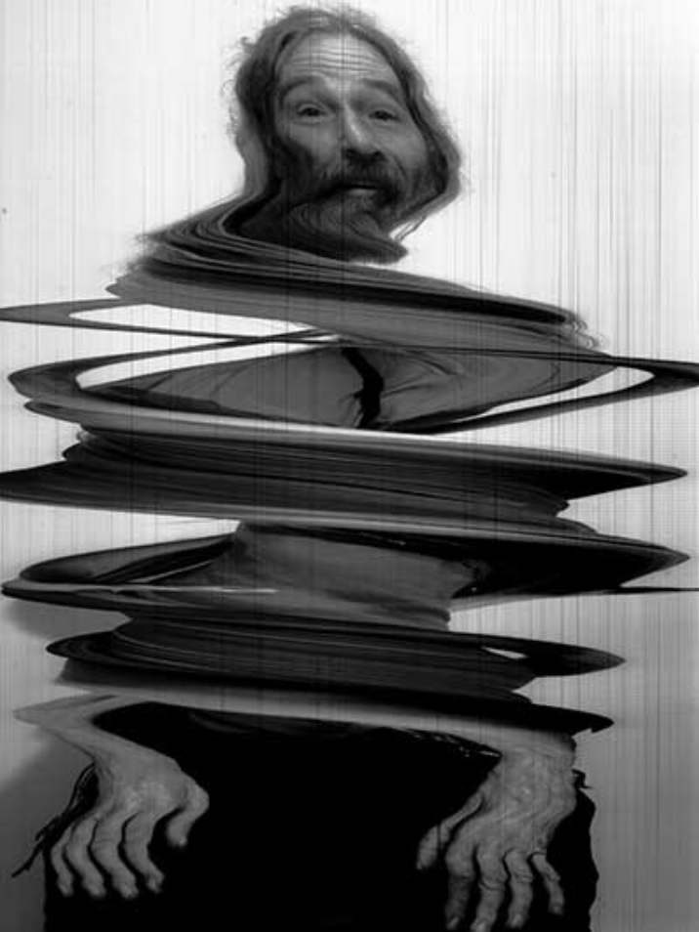
Idea and Motivation
--->Final Project: A short film
of slit-scan performance
Proposal: A projection Mapping Pop-up Book
(does not use the technics of the course)
Beau Daignault
Projection Mapping
Pop-up book
Slit-Scan(week8)
Motivation:
1.from myself: Parents and friends’ asking ; Data in phones-->Recommend me too many posts of applying master in UAL/RCA; Tutoring center’s call, which is making anxiety, crazy
The feeling of lost : future after Undergraduate is not decided yet.
2.from class: Slit-Scan’s whirling effect→ a lost feeling
Topic:
“How art students become lost when talking about their future “
--->Criticize the phenomenon; (don’t be so hurried, call for finding your real dream and desire.)
(chose 5 art & design schools as stages)

Slide 3
Process
1
2
3
Footage, Research & Consult
1st version & Consult
2nd version
AE & Slit-Scan Plugin
Research & Consultation

Slide 4

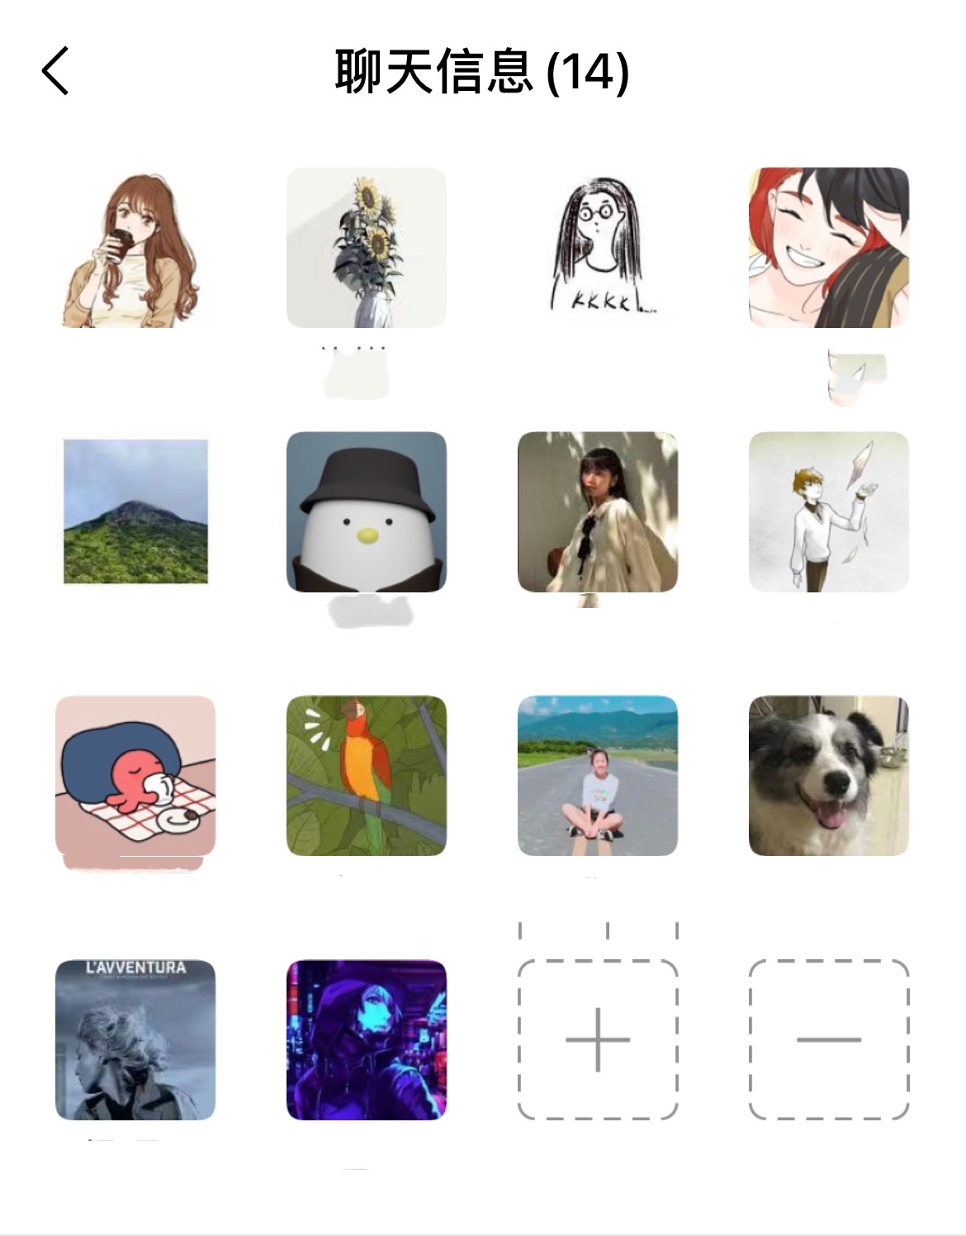
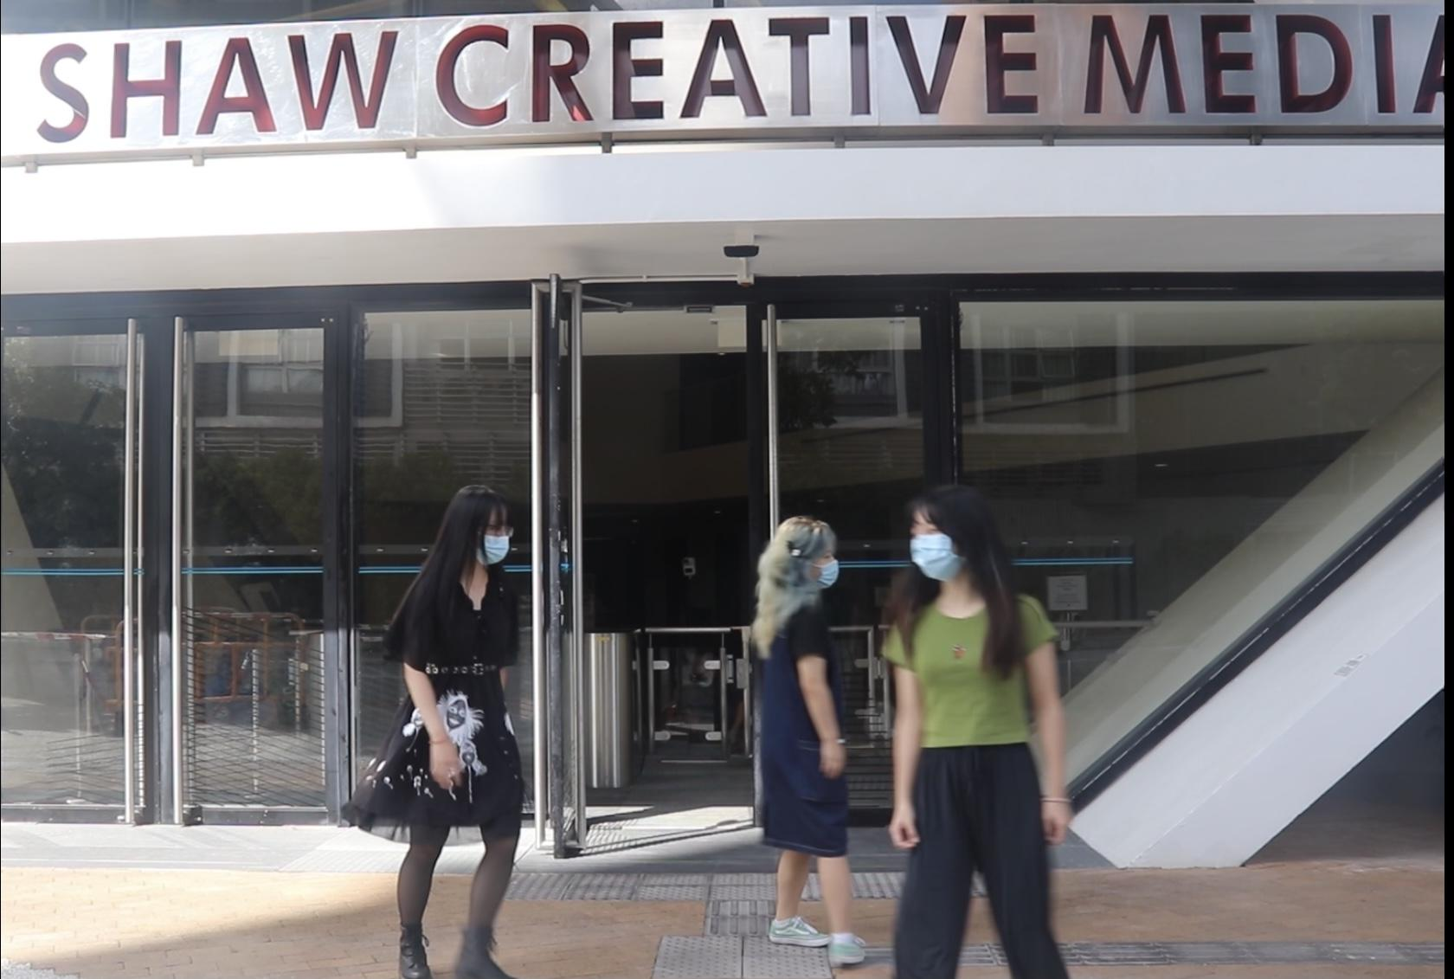
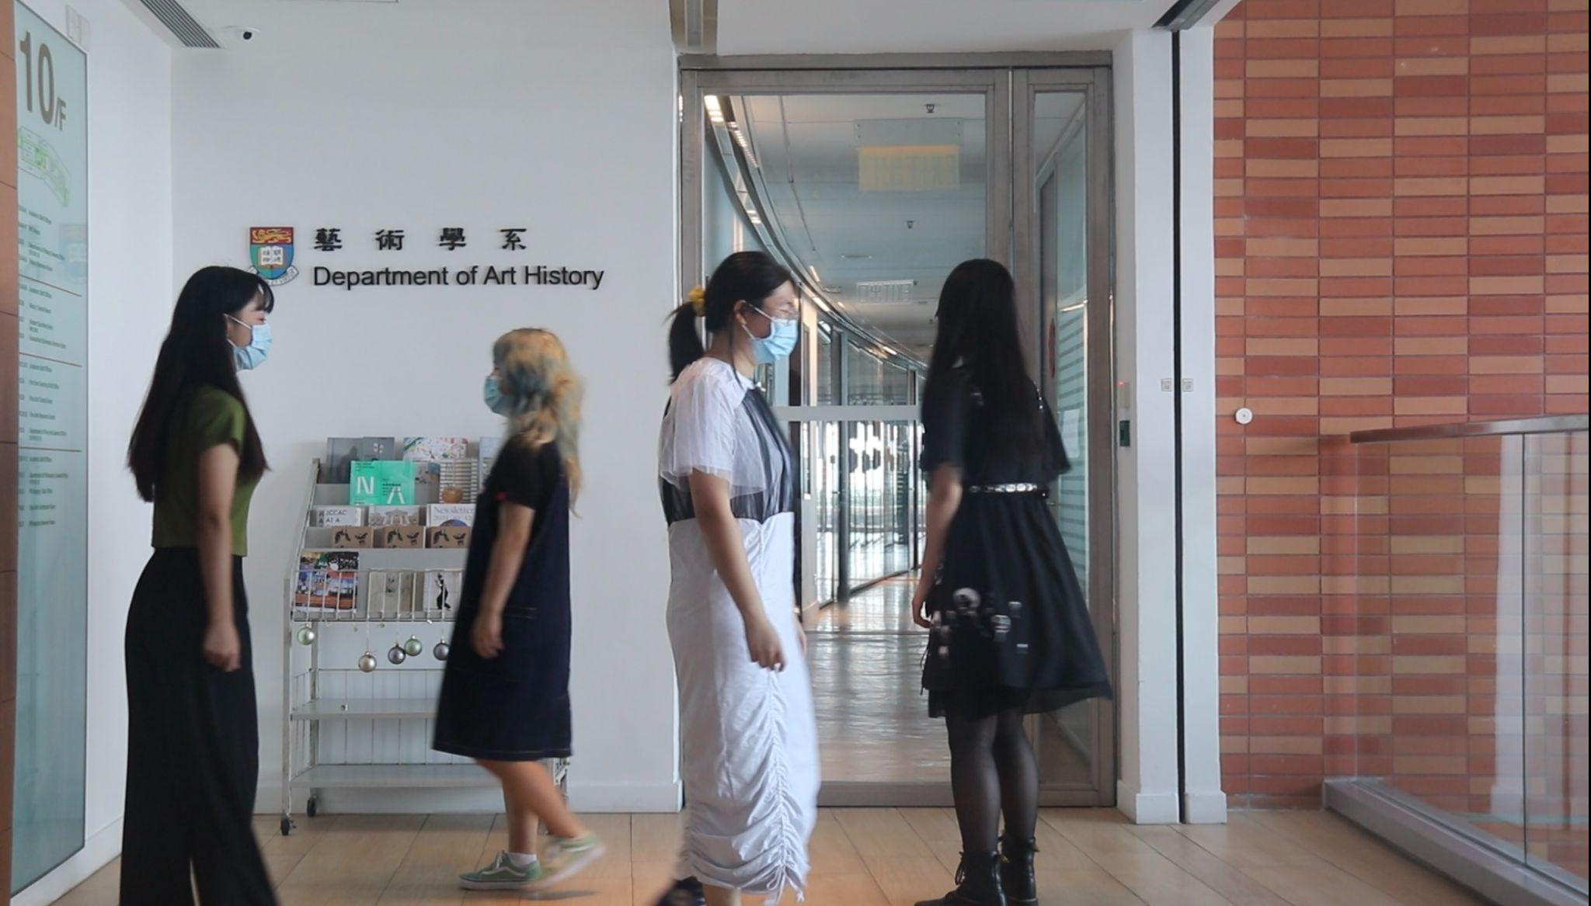
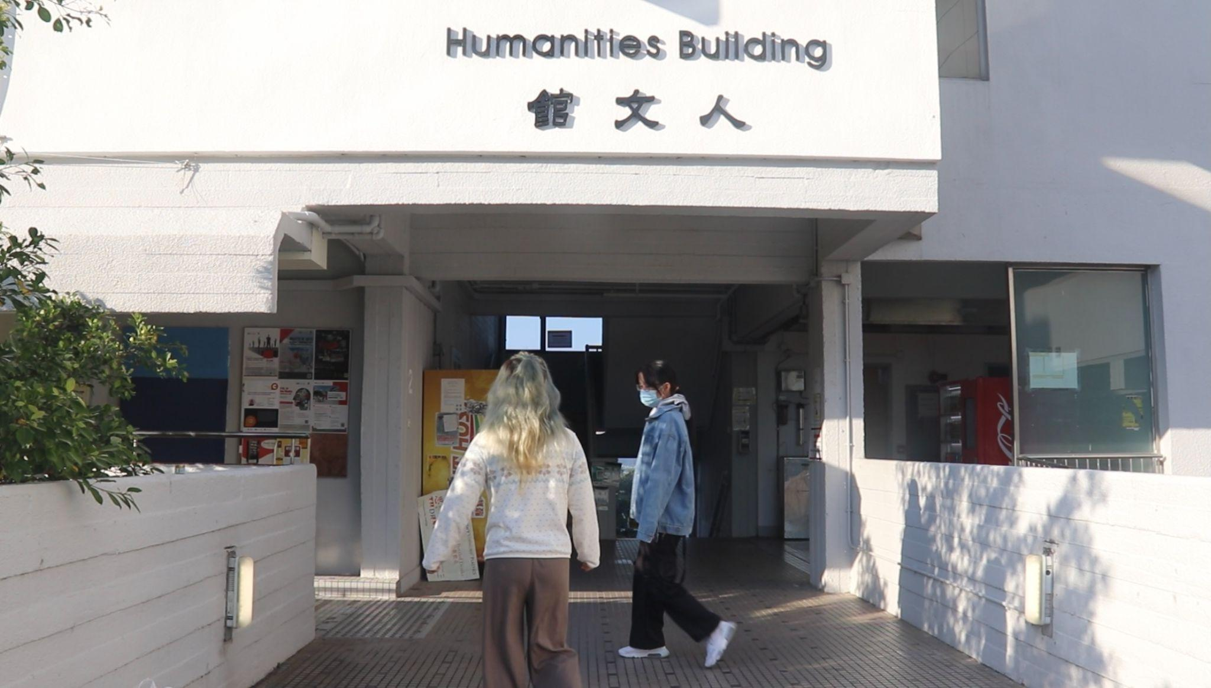
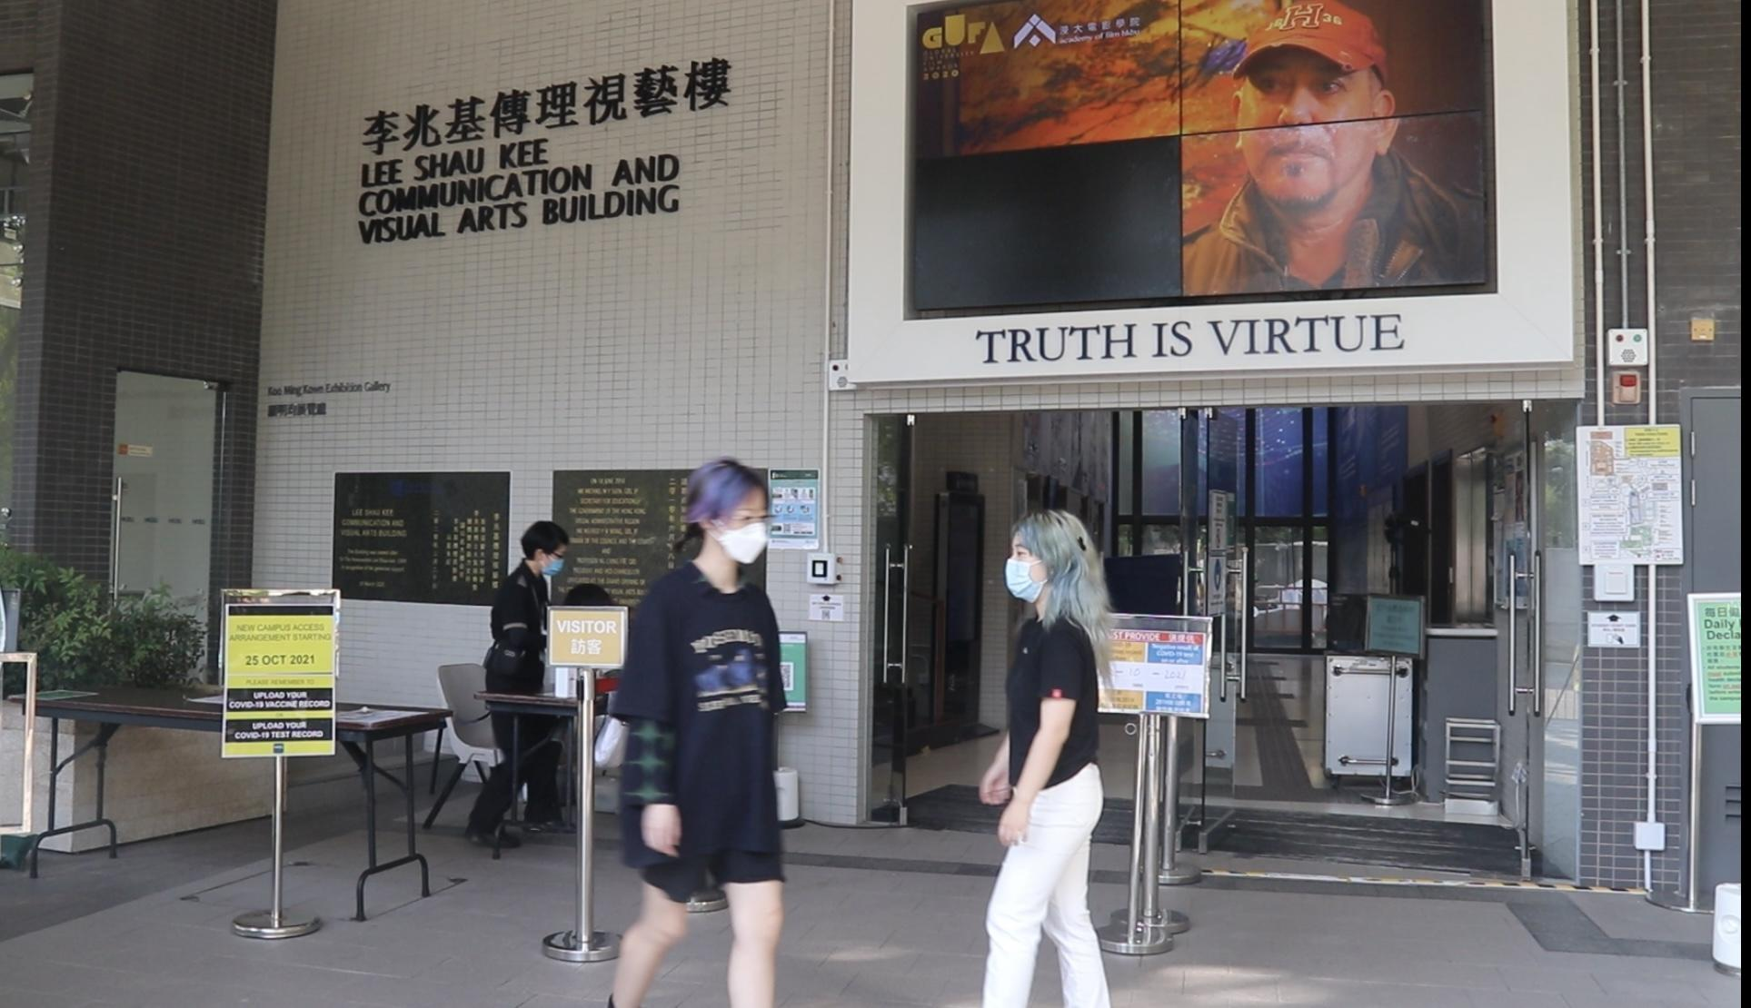
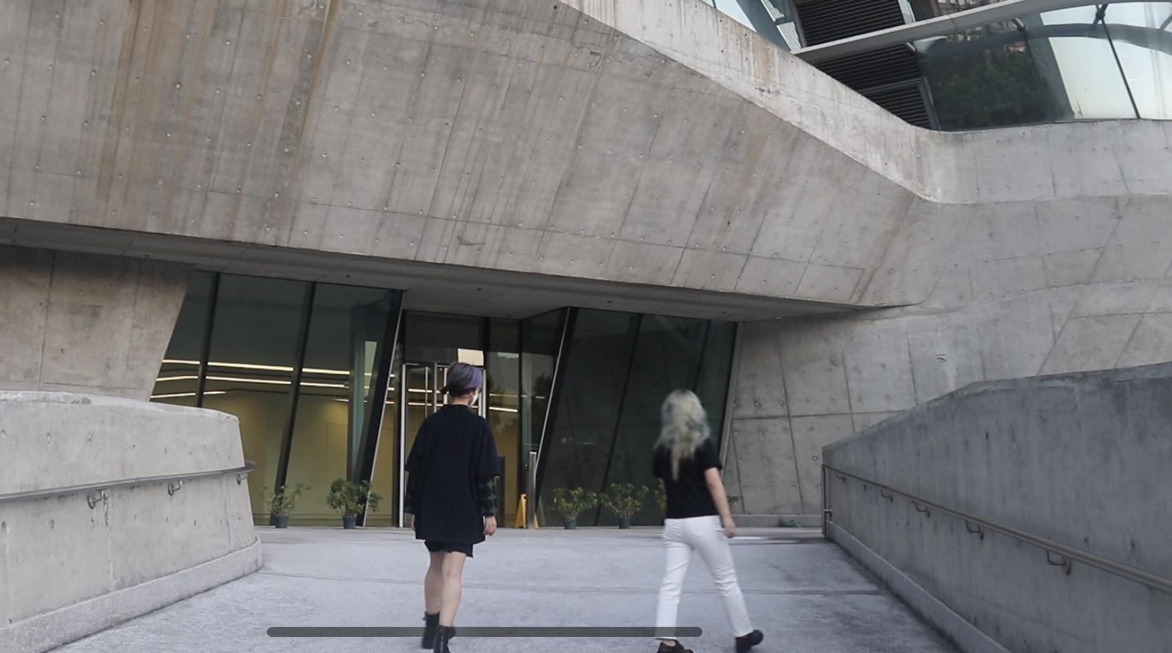
Art and Design Schools in Hong Kong...
CityU
Performance Stages Choosing...
CUHK
PolyU
Wechat Group for
Performers
HKBU
HKU
CityU
HKU
CUHK
HKBU
PolyU

Slide 5
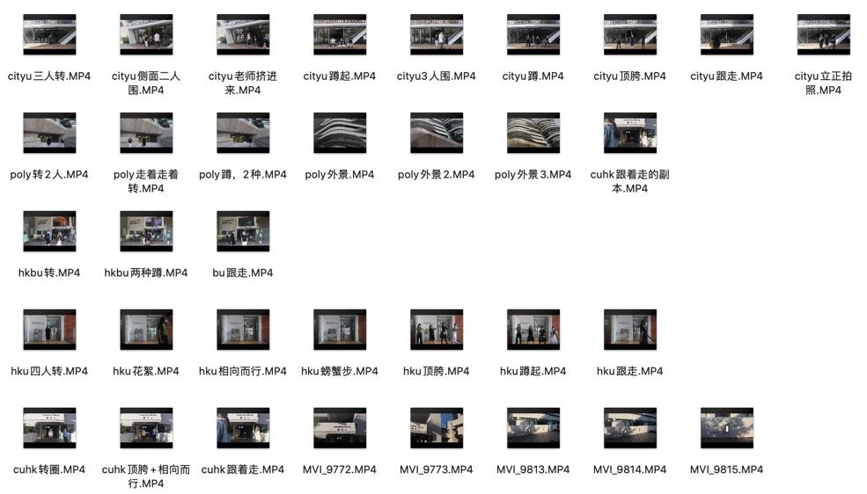
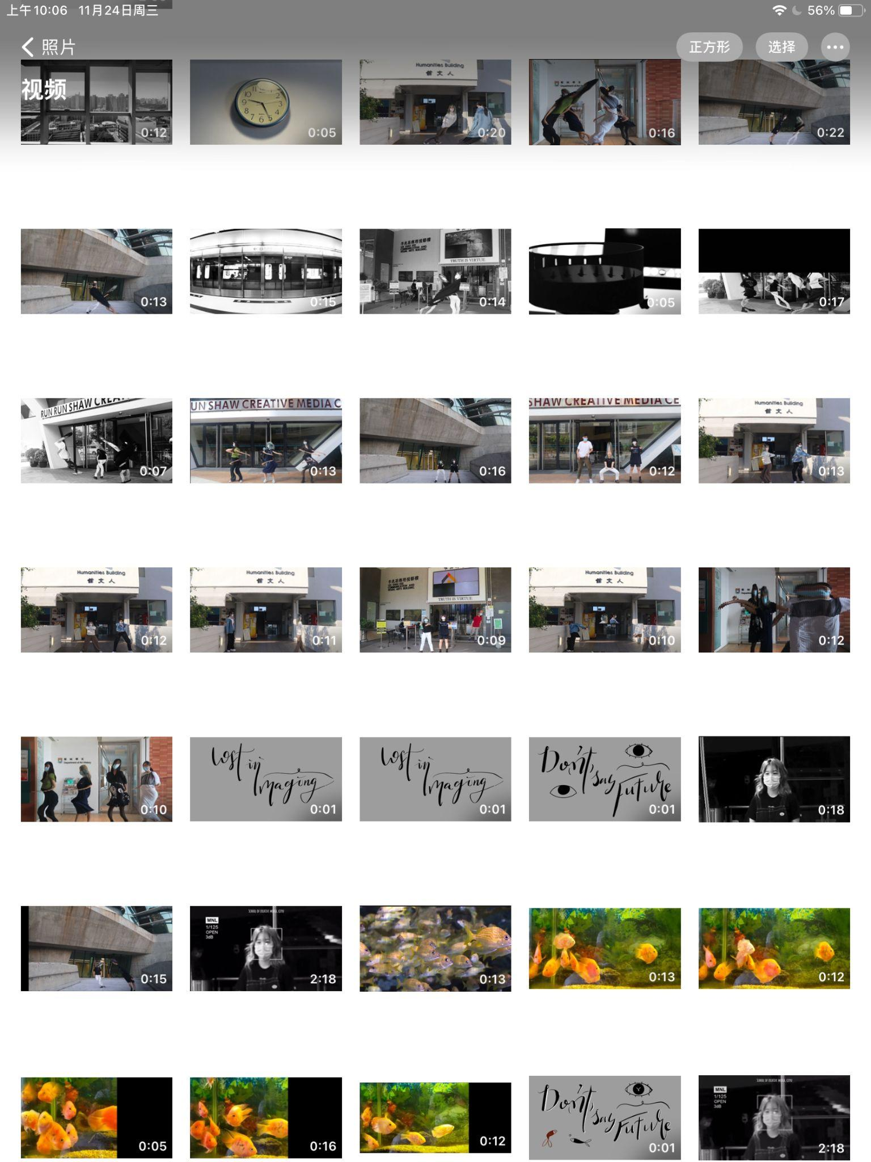
Difficulties
Recruiting People to join in is hard:
--Only half of the people in wechat group (6 people included me) performed
Shooting & Going to 5 schools are Time Consuming:
--But there is the spirit of art performance as well as this project;
Editing and making Slit-Scan Effect:
--AE is choppy. It takes 10 minutes to slit-scan a 7-sec footage; CPU got burnt.--> CMC? X
--Shooting other footages/materials to make this video more interesting.
--Airdrop the footages between ipad & PC back and forth to edit;
--Exporting for 12 times ---> Workload

Slide 6
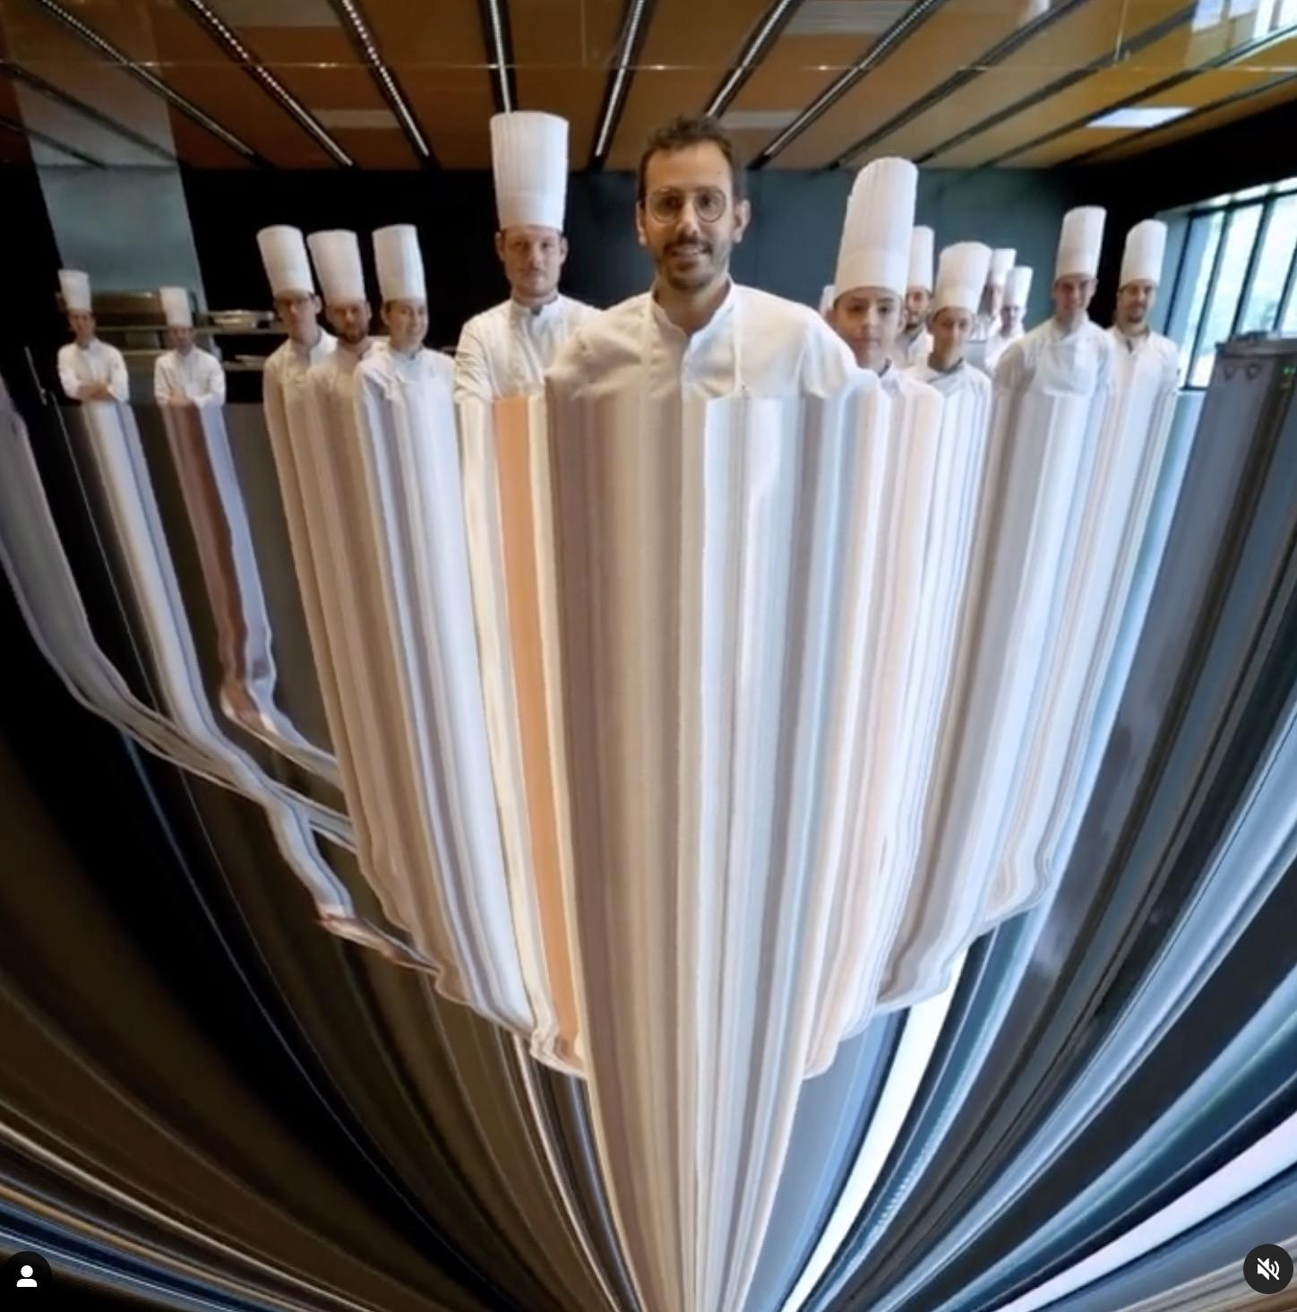
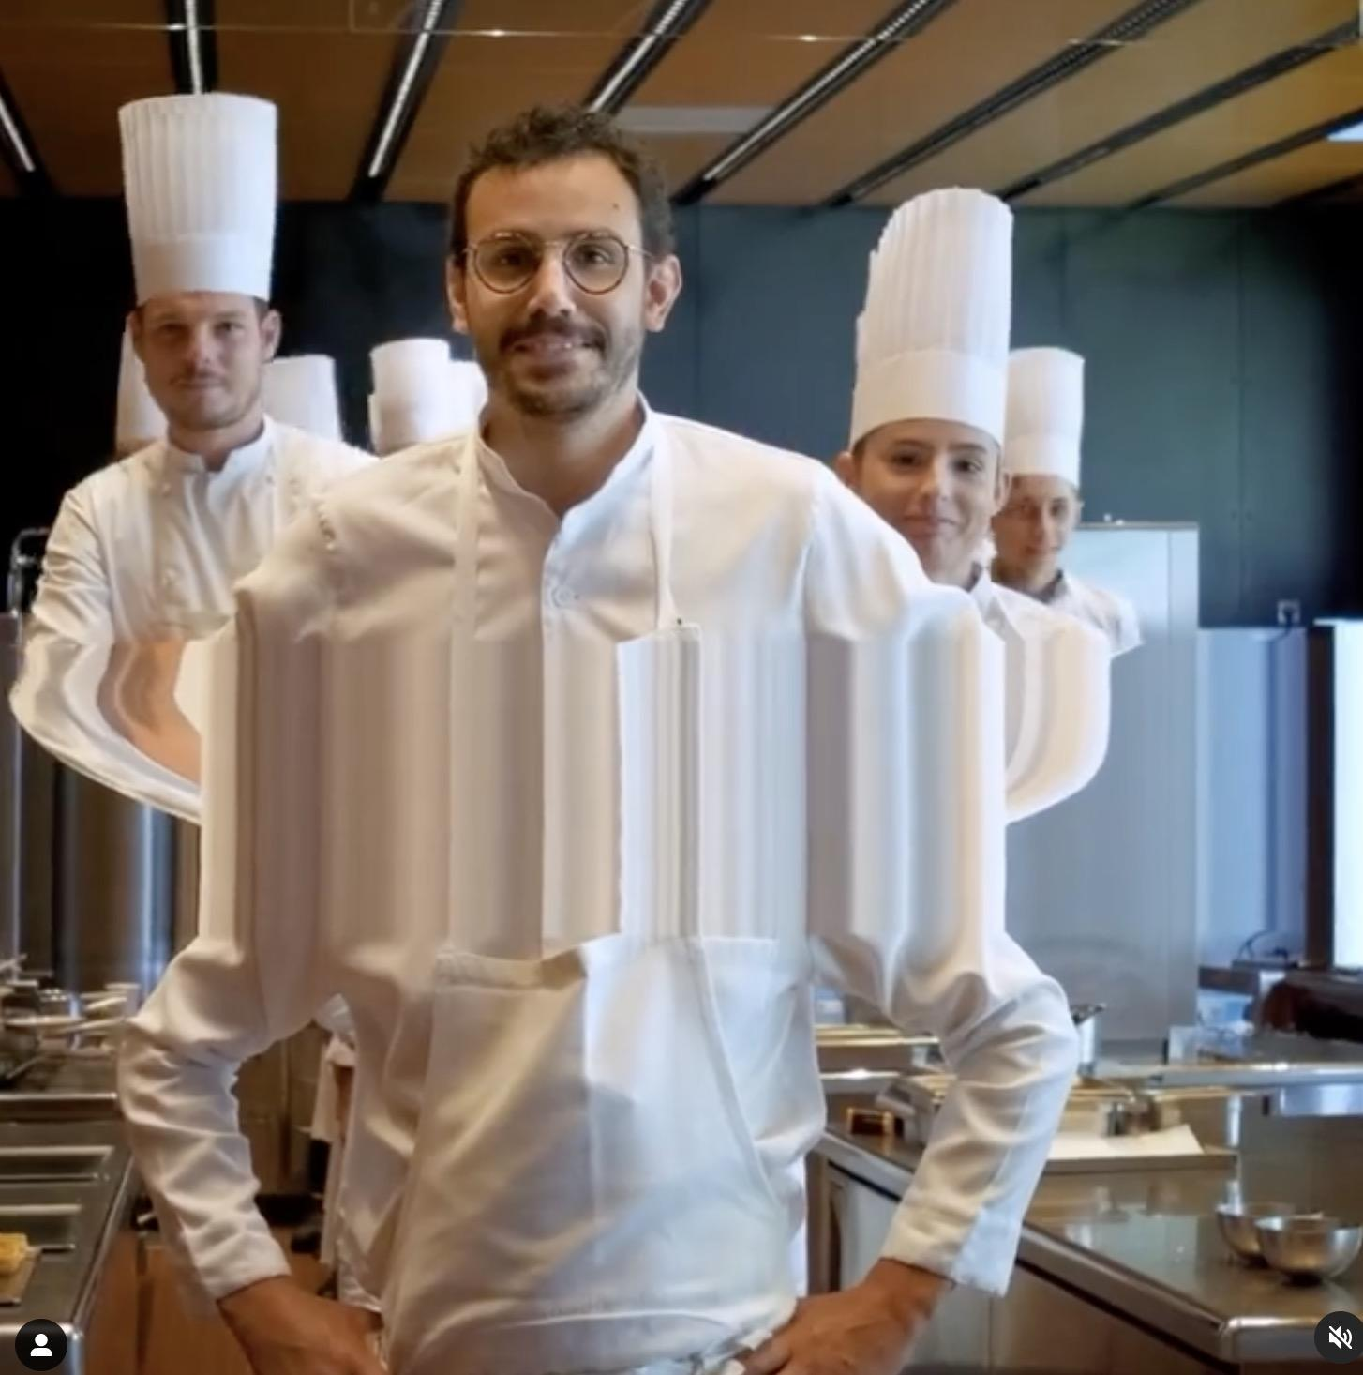
Suggestions in 1st Consultation
Make sure the main idea of this project:
Convey a feeling of missing goals; lost
Research: To avoid boring ( more surprising):
-->use the camera movement (Francois Vogel)
https://www.instagram.com/francois.vogel/

Slide 7
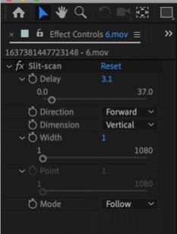
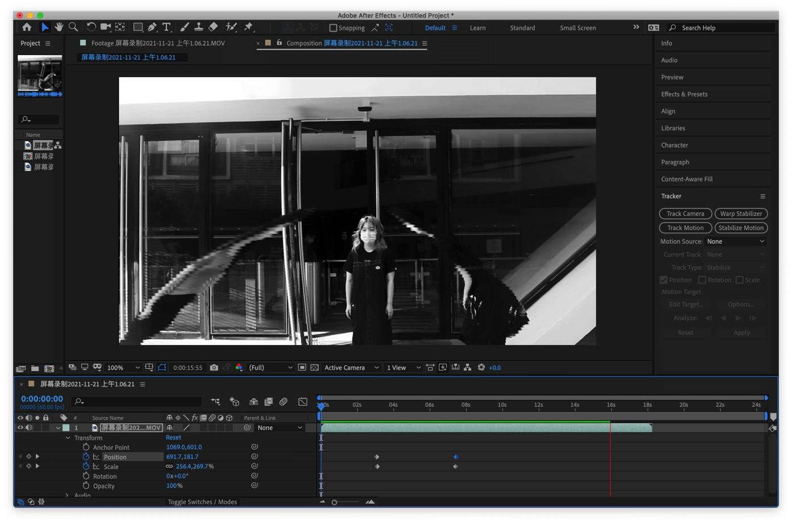
Adding key frames for camera movement
Slit-Scan Plugin

Slide 8
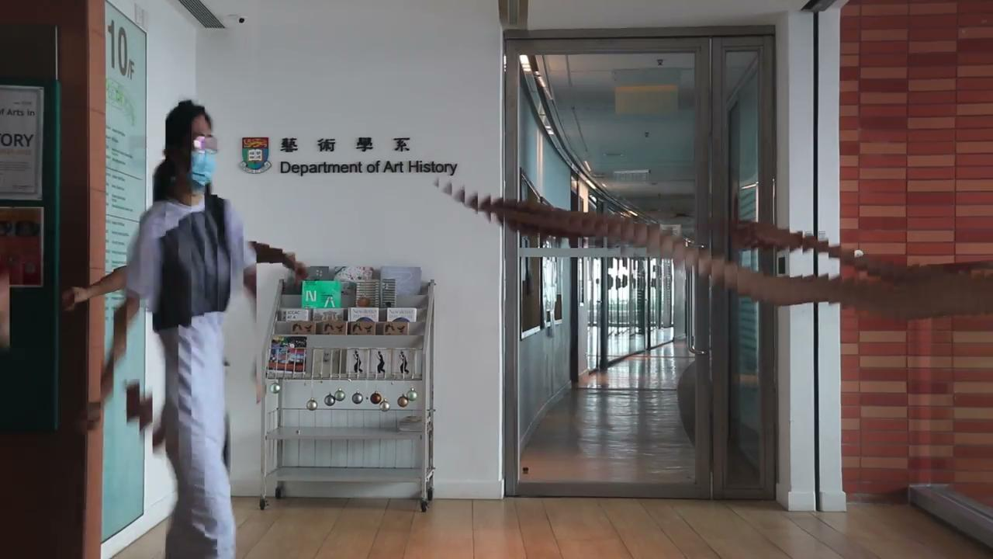
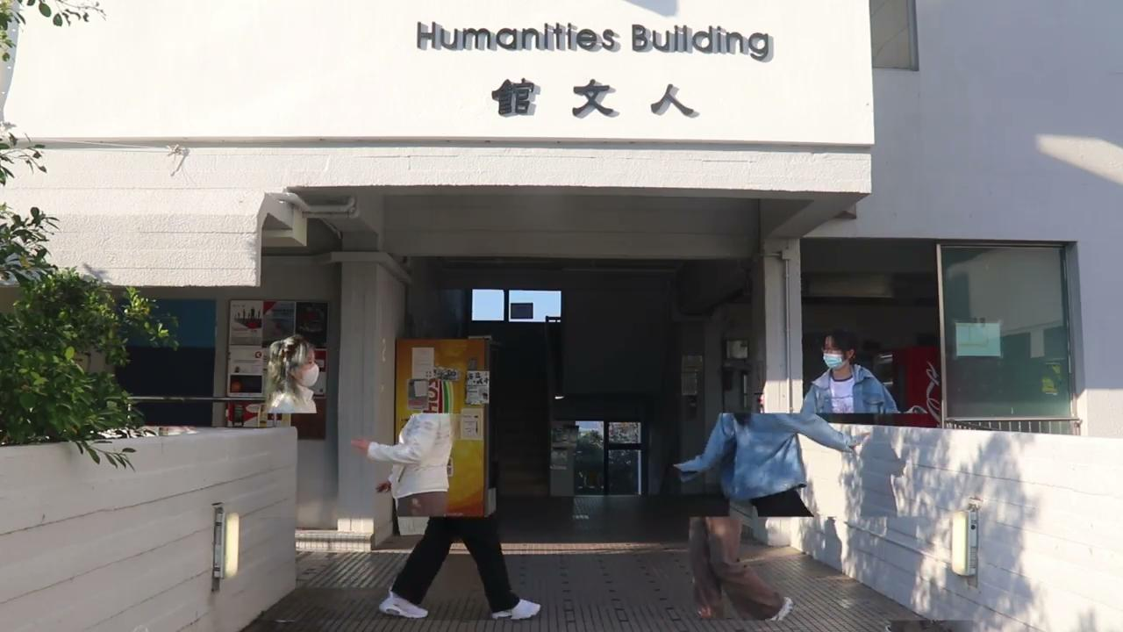
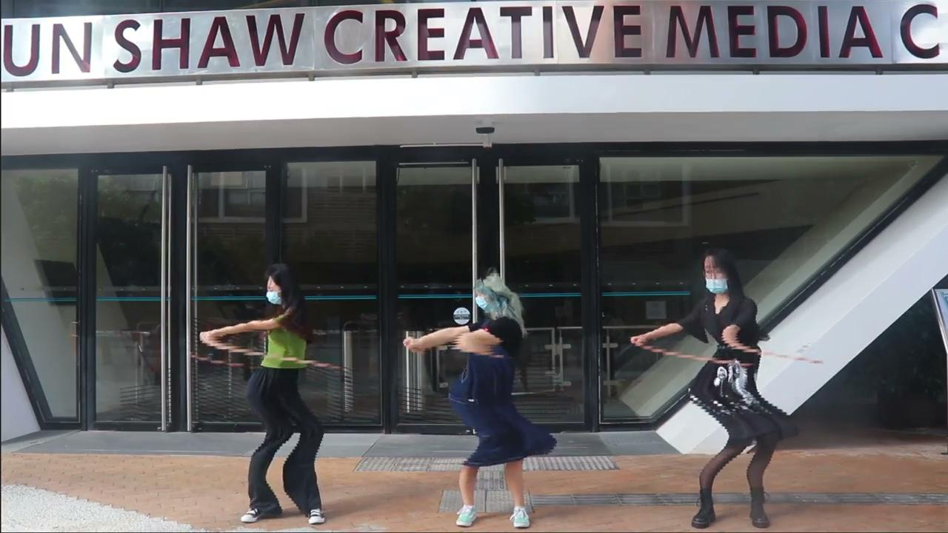
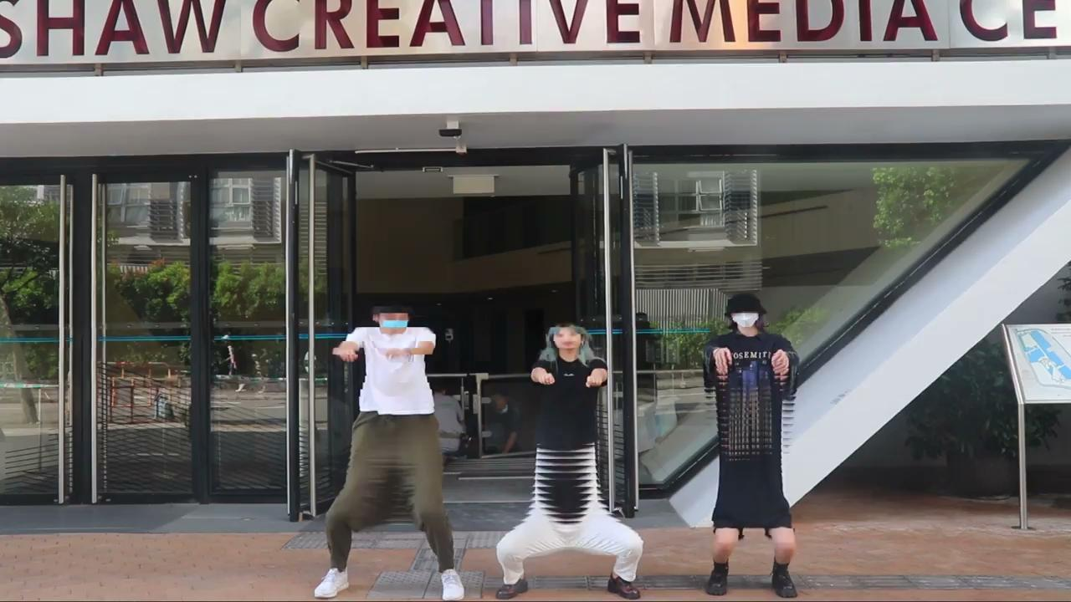

Slide 9
Process
1
2
3
Footage, Research & Consult
1st version & Consult
2nd version
1st version video
Ask for suggestions(2 times)

Slide 10
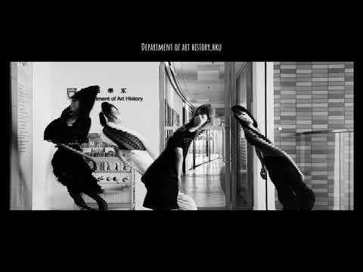
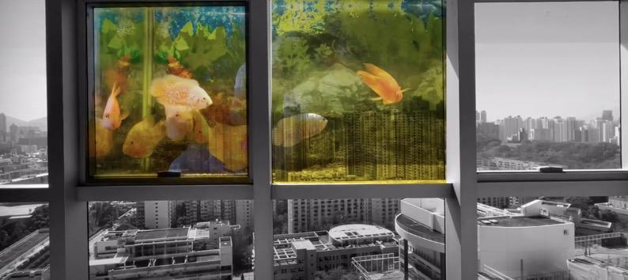
First Version
Suggestion in Consultation
1. Slit-Scan effect ----> AE or Processing
2. Duration of slit-scan footages-->Edit
3. What is the footage of “Fish”
for at the beginning?--->Inspiration of combining movement of fishes and performance
https://youtu.be/zYSW1cdu0sY

Slide 11
Process
1
2
3
Footage, Research & Consult
1st version & Consult
2nd version

Slide 12
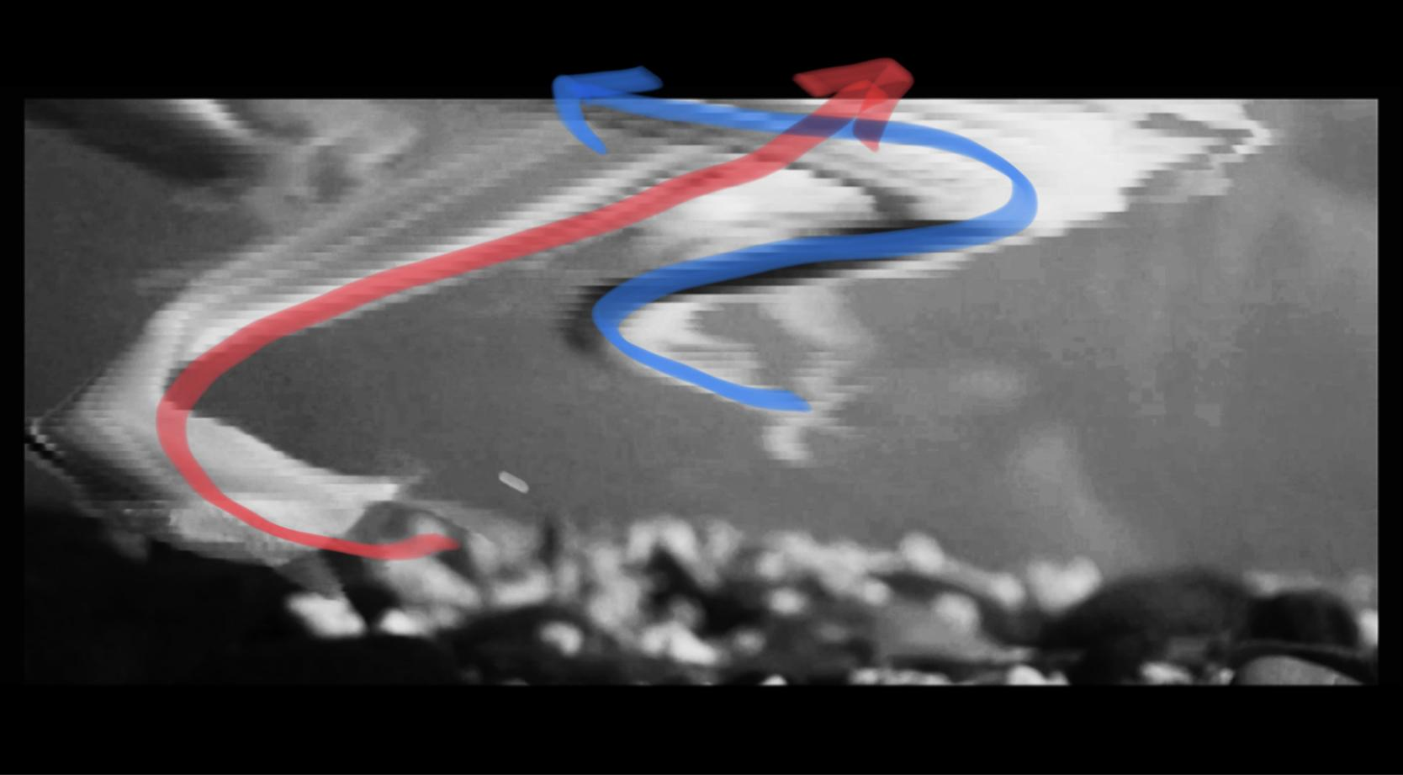
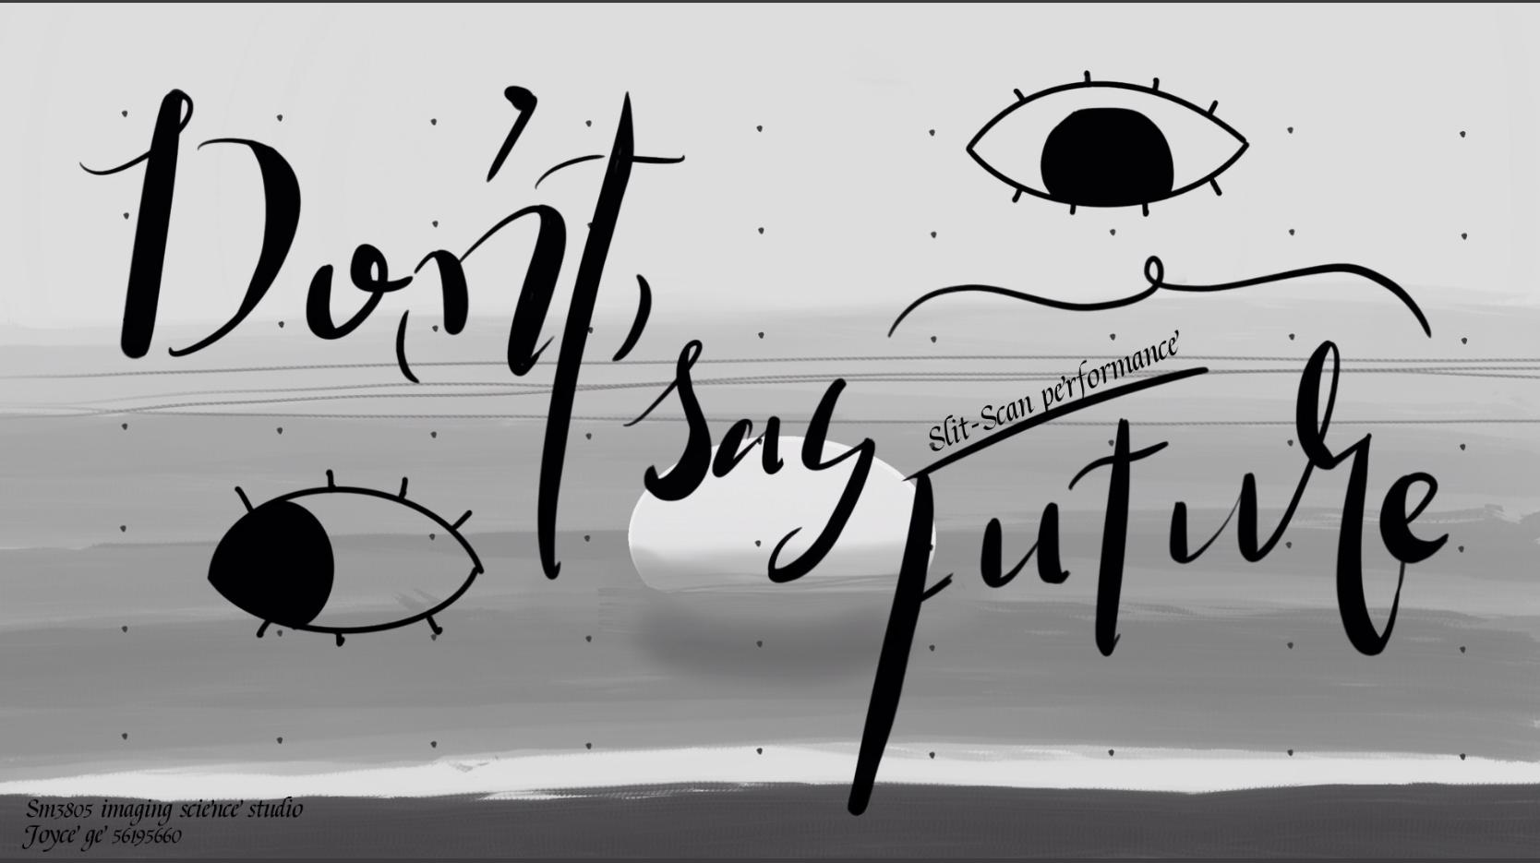

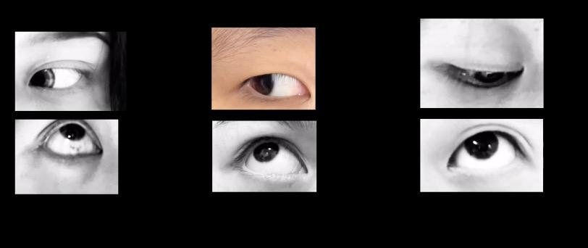
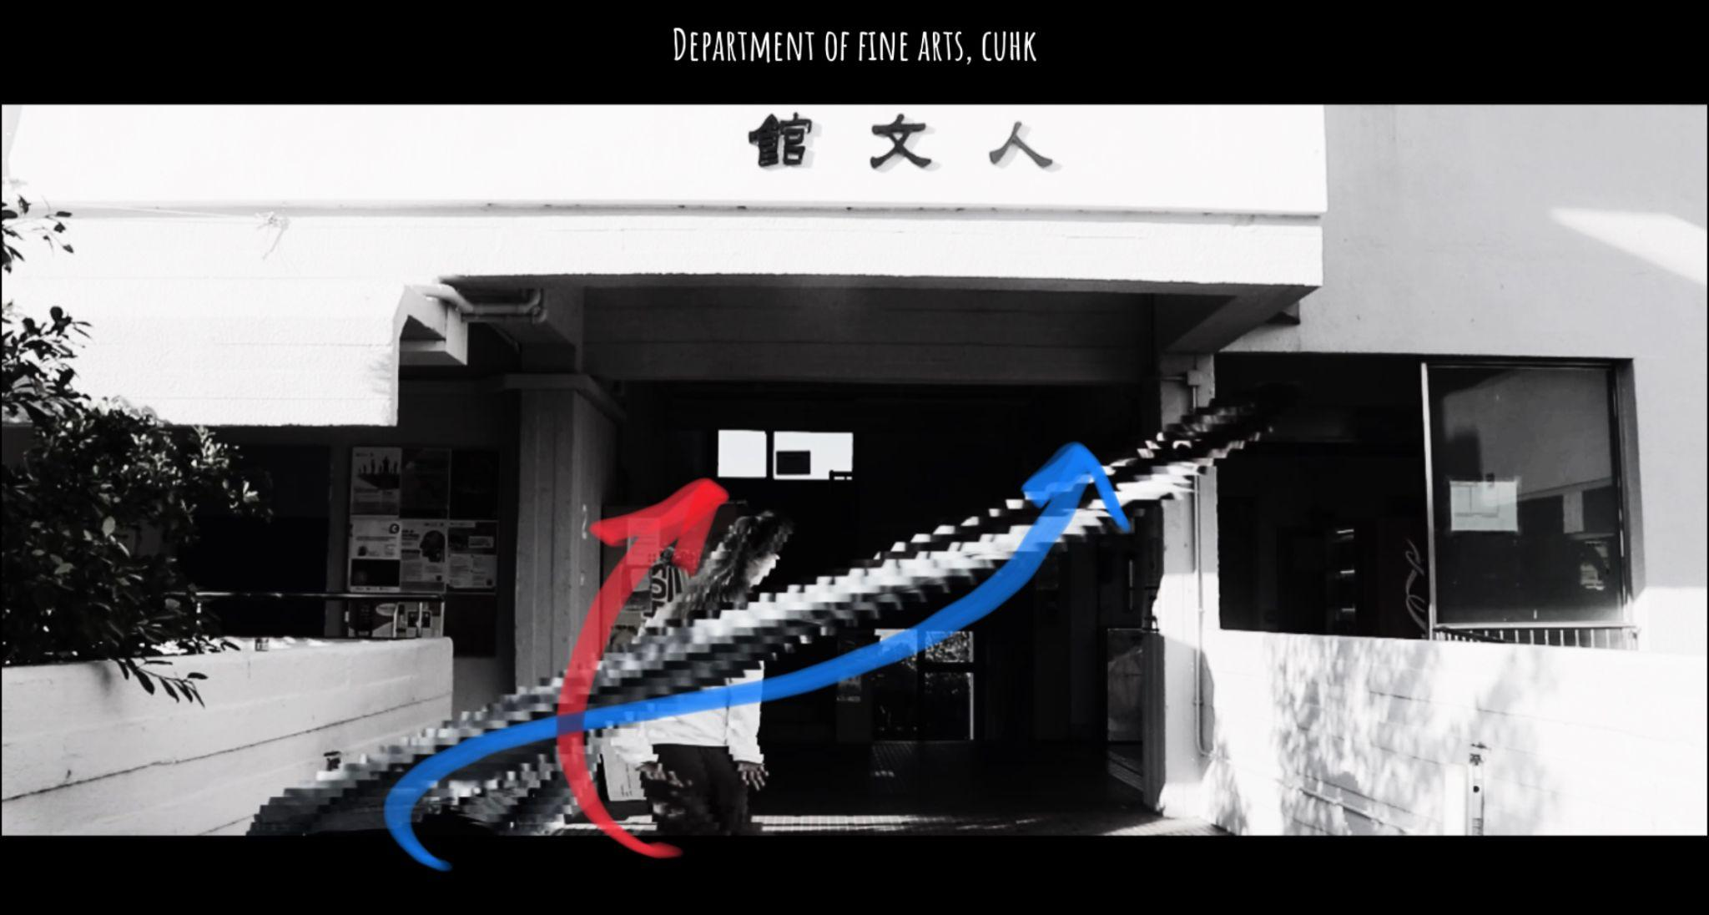
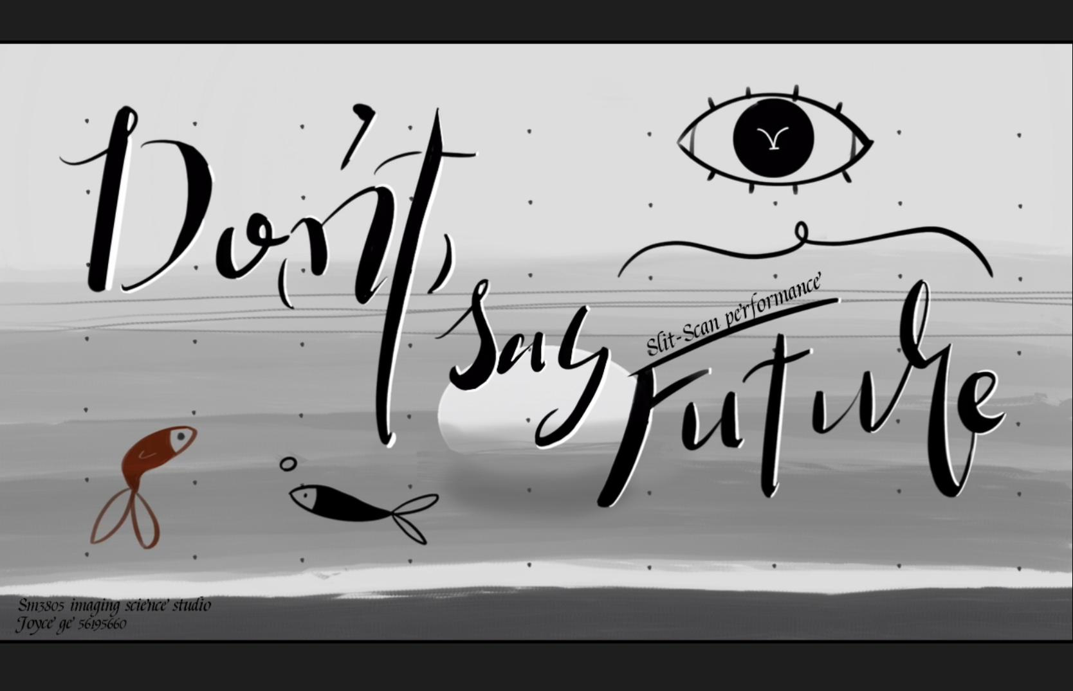
1st Version animation & footages
2nd Version animation & footages
Improvement
Movement of fish
Movement of performers

Slide 13
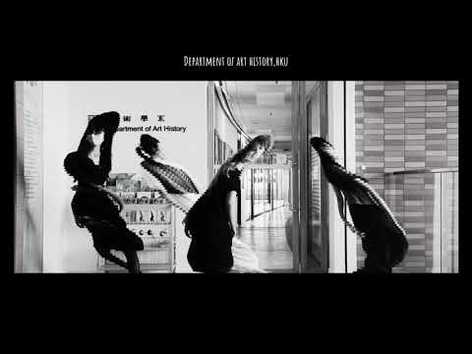
Project Outcome
https://www.youtube.com/watch?v=ypM62cNI--8

Slide 14
Reflection and Future Work
Good Points
1. Creativity & Originality
Slit-Scan Performance + Lost Feeling = Experimental short film
2. Use of the scientific concept
Better that my proposal (Projection mapping and pop-up book)
3. Have two times of consultation
Future Work
1.Video Making
The footages of fish ---> more resemblance
The Slit-Scan effect is not perfect ---> other tool
2. More Places to making performance
London; Chicago etc.
3.Good Habit of Making Artwork
Spend more time on consultation and group review---> less time on working/ reduce workload
Topic choosing; Plan making; More researches: Sequence of preparation; Looking for shining point; etc.
Shortage
1. Research is not enough
Should consider both topic and technical issues
2. Decide how to edit after getting footages
Where is the balance of both sides? ---> cannot avoid, so get start earlier
(3. The topic is personal, has limited audience)
Audience will be never limited if the final effect is impressing enough.

Slide 15
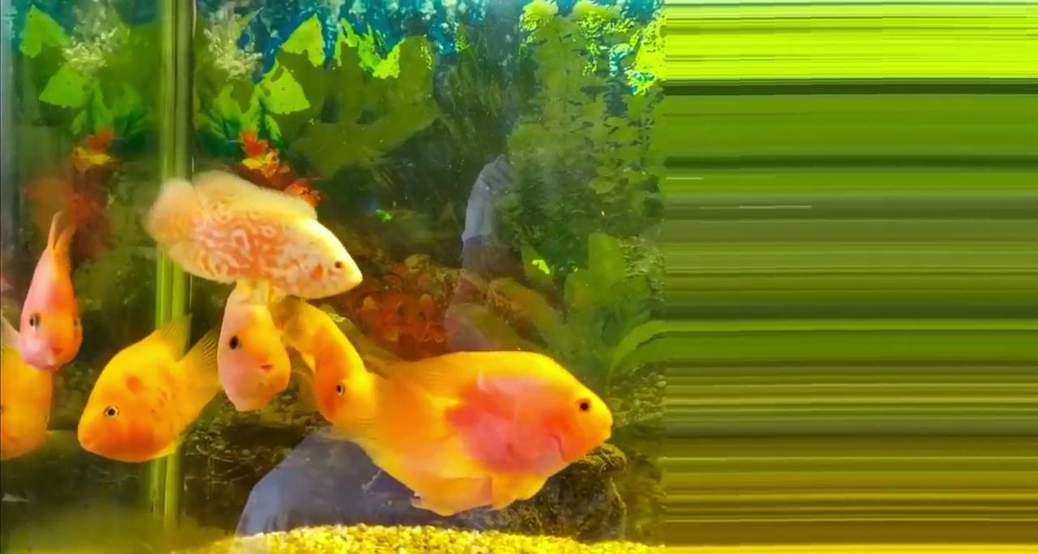
An interesting story of fishes..(needs imagination)

Slide 16
Reference
1.https://www.instagram.com/francois.vogel/
2.Shao Qingfeng. (2007). Audiovisual language. Communication University of China Press.
3.https://www.flickr.com/photos/beaudaignault/albums/72157623210711064
4.The Fourth Dimension (1988) by Zbigniew Rybczyński
https://youtu.be/LlVh0TCDDgU

Slide 17
Thank You

